Slide 2


Slide 3
History Of Bangladesh cricket
1. The marylebone cricket ground (mcc) tour of Bangladesh during the winter of 1976- -77 marked the enterence of Bangladesh in international cricket .
2. Bangladesh took part of 1982,1986,1990,1994 editions of ICC trophy, and won 1997 icc trophy.In the process qualifying for the 1999 world cup .

Slide 4
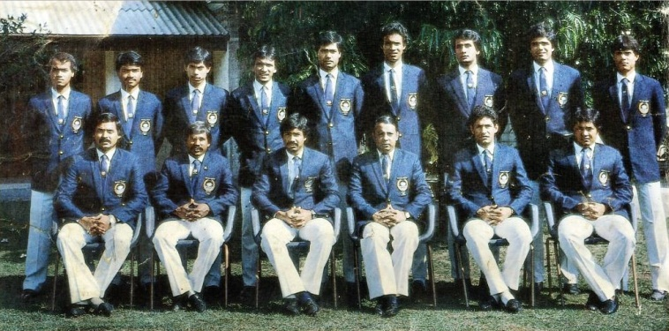

on 31 March 1986, Bangladesh played in its first ODI match against Pakistan in the 1986 Asia Cup
Bangladesh qualified for 1988 Asia cup ,hosting the cup and it was the first ODI tournament first staged in BD.

Slide 5
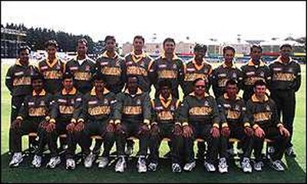
Bangladesh took part of 1982,1986,1990,
1994 editions of ICC trophy, and won 1997
icc trophy.In the process qualifying for the
1999 world cup
In 1999, Bangladesh played in their first world cup in England

Slide 6

Bangladesh is a full member of the
International Cricket Council (ICC) with
Test and One Day International (ODI)
status. It played its first Test match
in November 2000 against India in Dhaka.
It got the status of a Test playing
country on 26 June 2000.

Slide 7
BCB_Bangladesh Cricket Board
Bangladesh Cricket Board(BCB) previously known as Bangladesh
cricket control board is the main governing body of Bangladesh
cricket.
It works for the development and maintains of Bangladesh cricket ,
their venues and academy.
The Board has its headquater in Mirpur in Dhaka.
It is operated by the government of Bangladesh

Slide 8
Bangladesh Cricket
Performance in Test

Slide 9
UNITY AMONG CRICKETERS

Slide 10
Test Performance
It has played its first test match in 2000 against INDIA at Bangabandhu Stadium,Dhaka and becoming tenth test cricket nation.
Bangladeshi batsman Aminul Islam hit a century in debut test match.

Slide 11
RECORDS
Highest team total: 638 vs Srilanka , 8 march,2013
Highest team total :326/3 vs Pakistan in 2014
Bangladesh defeated Pakistan 1999 Cricket world cup .
Most wins: Bangladesh won 36 matches against Zimbabwe

Slide 12
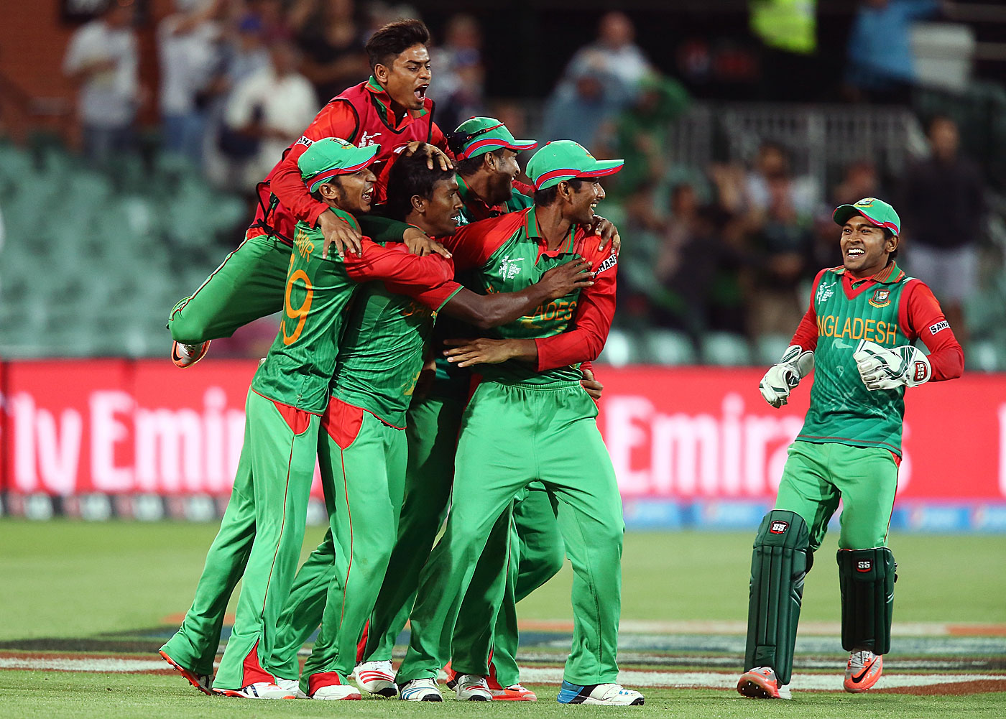
Team celebration

Slide 13
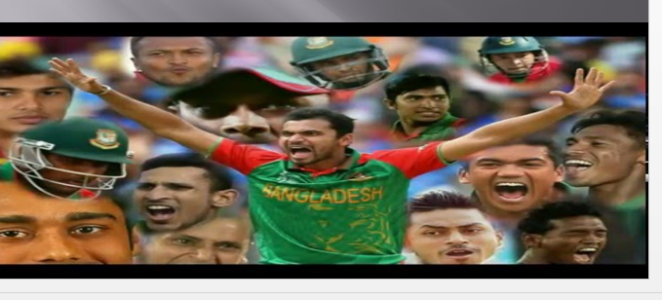
Twenty T-20 Bangladesh performance in this shorter version of cricket is very poor .As they are ranked 10th position in this format.

Slide 14
Individuals records
*Little master MD.Ashrafull is the youngest player in the world cricket who scored
a century in his debut test ,when he was only 17 years 61 days old.
*Highest individual score : 206 runs
scored by TAMIM IQBAL vs Pakistan
*Highest opening partnership :312 runs
scored by TAMIM IQBAL & IMRUL KAYES
*Most test wicket for Bangladesh : 147 wickets By SAKIB AL HASAN

Slide 15
ASIA CUP CRICKET
Asia cup started in 1986 but Bangladesh started playing in 1984.
In 2004 they beat Hong-Kong and in 2008 they beat UAE.
Bangladesh in world cup
Bangladesh hosted 2011 world cup with India and Srilanka .

Slide 16
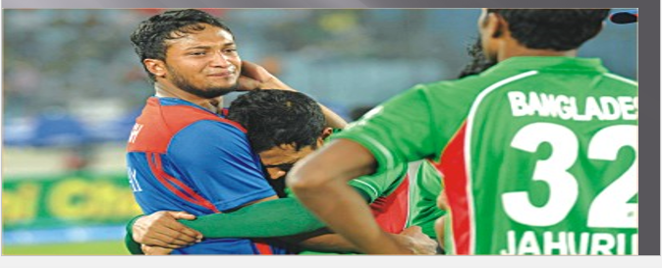
2012 Asia Cup
Bangladesh hosted Asia cup in 2012 and they beat India, Srilanka and reached in the final…but unfortunately lost in the final by 2 runs and made the whole nations cried for it.

Slide 17
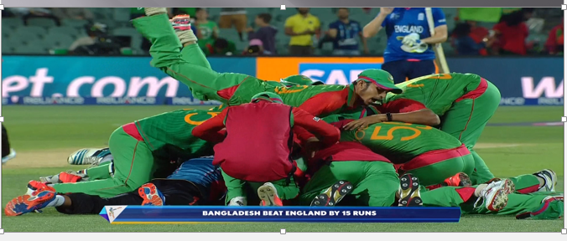
2015 world cup
This is the most historic world cup for Bangladesh . Bangladesh beat Afganishtan and Scotland and mighty England and qualify for quarter final .

Slide 18
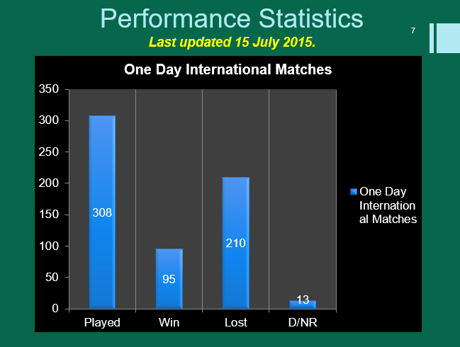

Slide 19
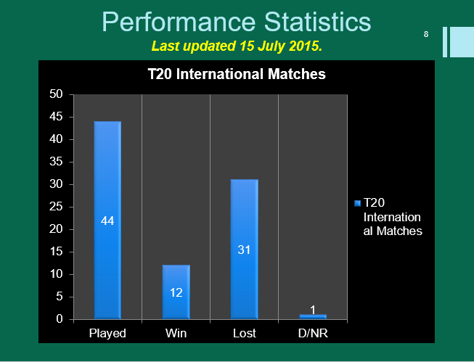

Slide 20
How World's Best Cricketer increases Unity
SAKIB AL HASAN
In 2009 Shakib became the number one all rounder of one day international cricket. In the same year he got the prestigious recognition of Wisden Cricketer of the year. He also became the first Bangladeshi to play in the English County Cricket League. In 2012 he also became the number one all rounder of test cricket.
The best all rounder in all 3 formats of cricket
SAKIB AL HASAN

Slide 21
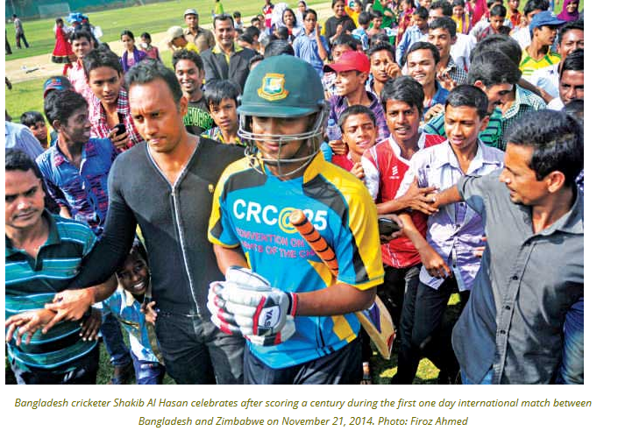

Slide 22
How World's Best Cricketer increases Unity
In July–August 2009, Shakib took over as captain. He and Mahmudullah led Bangladesh's bowling attack
and securing a historic win for Bangladesh. It was Bangladesh's first vectory against the West Indies.

Slide 23
Shakib was appointed captain for Bangladesh's tour of Zimbabwe in August 2009In the second ODI of the five match series Shakib scored 104 – his third ODI century – to help his team to their highest score in ODIs and lead Bangladesh to a 2–0 lead in the series

Slide 24
As he was struggling to cope with the captaincy and his role as an all-rounder ,he managed both of this successfully.
The Bangladesh Cricket Board founded the six-team Bangladesh Premier League in 2012, a twenty20 tournament to be held that year. The BCB made Shakib the 'icon player' for Khulna Royal Bengals.Under his captaincy, Shakib's team progressed to the semi-finals of the competition.

Slide 25
In 2015, Shakib helped Bangladesh to their most successful year in cricket. Following their success in the 2015 Cricket World Cup, he also helped the team to a white wash of Pakistan and series win against India and South Africa. This is how a teamleader takes his team towards successes.

Slide 26
A changed approach and teamwork ignite Bangladesh on landmark Test
Following a comprehensive 259-run defeat, they were down and out at Galle, a senior member of the team was dropped from the squad in the middle of a series, the team management
was not entirely happy with the performance of some of the other experienced pros — coming into their landmark 100th Test match, all was not well in Bangladesh’s camp.

Slide 27
A changed approach and teamwork ignite Bangladesh on landmark Test(cont..)
More of less ahead of the P Sara Oval Test match Mushfiqur
and his team was pushed back in the corner. They had only
one option left — beat a strong opponent like Sri Lanka at
their own backward and earn back their respect.
And that’s exactly they did.

Slide 28
A changed approach and teamwork ignite Bangladesh on landmark Test(cont..)
That closed door meeting
Before the start of the second Test, one of the training days at the
P Sara Oval, Bangladesh players sit back in the dressing room
and had a ‘heart to heart conversation.
Perhaps, on that particular meeting, the Bangladesh players
decided to change their approach. By the time the meeting
ended, the Shakibs, the Tamims, the Mustafizurs and the others
had understood the value of doing the basics right.
Also, they probably would have discussed about playing as a team,
rather than depending on individuals to come good.

Slide 29
A changed approach and teamwork ignite Bangladesh on landmark Test(cont..)
A team effort
Individual brilliance can win you occasional ODIs and T20s, but
not Test matches.Finally, it seems the Tigers are out of that zone.
It was probably for the first time in last 17 years, Bangladesh
boys dominated a Test match throughout the five days and put
up a purely professional display. It seems finally Bangladesh have
announced their arrival at the Test arena.

Slide 30
Relation Between Cricketer
and general People

Slide 31
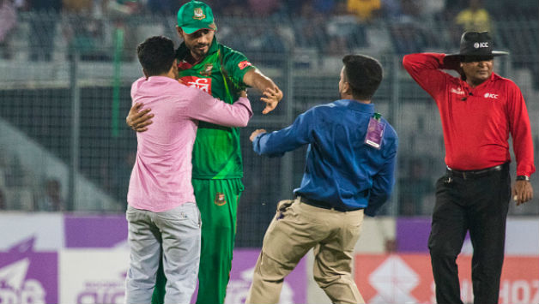
In a heartwarming gesture Mashrafe Mortaza protects a pitch-invader from security officials

Slide 32
In a heartwarming gesture Mashrafe Mortaza protects a pitch-invader from security officials(Cont…)
The incident happened during the 29th over of Afghanistan's innings.
Afghanistan were struggling at 102 for seven in chase of 280 to win
when the fan managed to evade the on-field security and ran
towards Mortaza who was fielding at mid-on. At first Mortaza tried to
get away from the pitch invader but as soon as he realized that the
person is his fan, the Bangladesh skipper shook is hands and
embraced him.

Slide 33
In a heartwarming gesture Mashrafe Mortaza protects a pitch-invader from security officials(Cont..)
The on-ground security officials soon caught up with invader
and tried to grab him by his collar to eject him, but Mortaza
kept the security personnel at bay and all the while protected
the fan. Mortaza tried to calm the situation down and kept the
fan away from the visibly angry security guards. Mortaza was
seen escorting the fan outside and kept on telling the security
to not harm him or act aggressively. Even after he was being
whisked away, Mortaza kept his eyes on the fan and even
gestured the security to deal with the situation calmly.

Slide 34
Environment of Unity During
Cricket Match

Slide 35
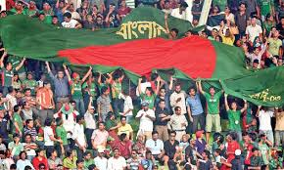
Environment of unity during Match

Slide 36
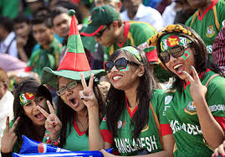

Slide 37
FUTURE HOPE

Slide 38
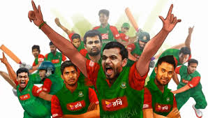
Stuart Law, the outgoing Bangladesh coach, has said the future of Bangladesh cricket is bright with young players such as Nasir Hossain in the national team and exciting talent waiting in the wings. However, he pointed out that the youngsters would need to be handled properly.

Slide 39
Asia cup cricket
Asia cup started in 1986 but Bangladesh started playing in 1984.
In 1988,1995,m1997,2000 they have attained in Asia cup but could not do well.
In 2004 they beat Hong-Kong and in 2008 they beat UAE.

Slide 40
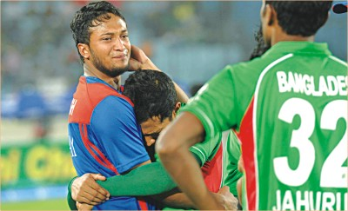
2012 Asia cup
Bangladesh hosted Asia cup in 2012 and they beat India, Srilanka and reached in the final…but unfortunately lost in the final by 2 runs and made the whole nations cried for it.

Slide 41
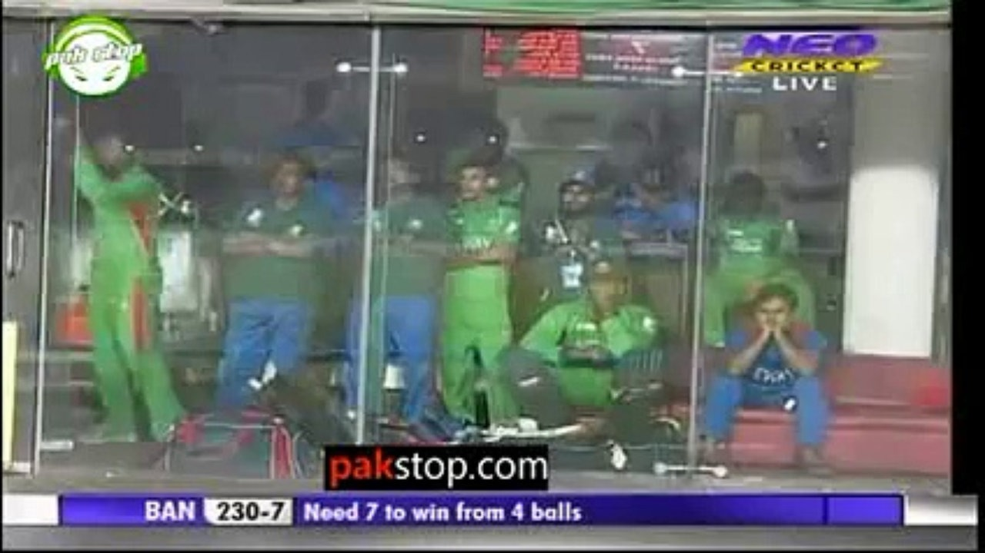
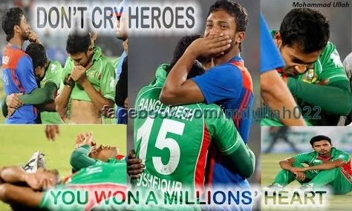
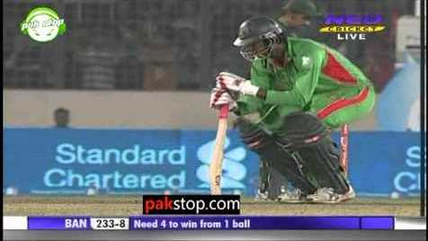

Slide 42
World cup cricket 2011
The 2011 ICC Cricket World Cup was the tenth Cricket World Cup. It was played in India, Sri Lanka, and (for the first time) Bangladesh.
It was a historical event for Bangladesh as it was a remarkable event for the whole nation.Whole nation got united for this event to made it a successful one.

Slide 43
World cup cricket 2011
The opening ceremony was held on 17 February 2011 at Bangabandhu National Stadium, Dhaka,and the tournament was played between 19 February and 2 April. The first match was played by the Indian and Bangladeshi teams at the Sher-e-Bangla National Stadium in Mirpur, Dhaka. The final was between India and Sri Lanka at Wankhede Stadium, Mumbai.
Bangladesh could beat England another giant champion team. But they were defeated by South Africa and West indies with a very poor score.

Slide 44
WORLD CUP 2015
The year 2015 has been a crucial one for all cricket-playing nations, more so because it was an ICC World Cup year.
However, even if one excludes that, it was a remarkable year for one particular cricket team .

Slide 45
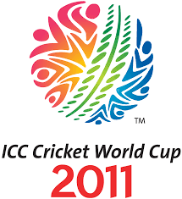
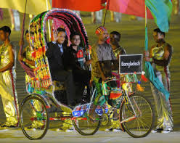
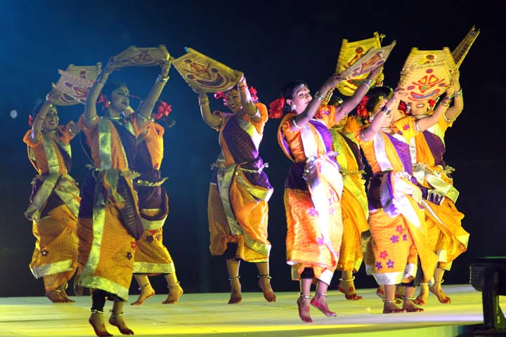


Slide 46
Defeating the big guns of cricket time and again, they proved they are not to be taken lightly, and that they are the new power when it is about the game of cricket.
The name of the team is “Bangladesh”.

Slide 47
The best playing of a team can make the nation’s people
united and patriotic to their country. Unity and patriotism is
essential for the development of a country.
If countrymen cannot feel themselves superior they cannot be
superior. They may have love for other countries if they see
them as the best. If a nation is not united for the common
good of the people and instead are involved in clashes and
political instability, they cannot be developed. Clashes,
violence, and political instability have negative impact on social
peace and development. In such circumstances, games such as
cricket can play an important role to unite the nation.
I

Slide 48
HISTORIC WIN
Bangladesh started their ICC Cricket World Cup 2015 campaign with 3 wins in 7 group matches.
They qualified for the knock-out stage to face India, their most remarkable win being that over the England team who were being considered as one of the strong contenders to lift the cup.

Slide 49
HOW THIS WIN AFFECT THE FAN
Cricket-mad Bangladesh erupted in joyous celebration after the National Team dumped England out of the World cup.
Impromptu victory processions broke out across the country.

Slide 50
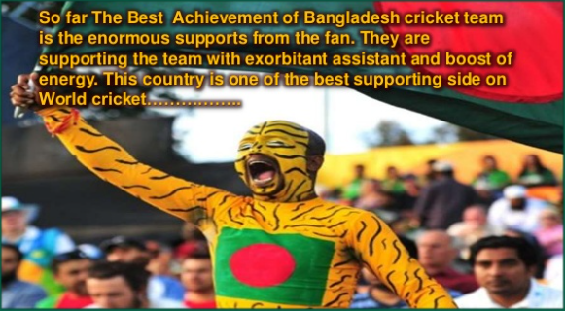

Slide 51
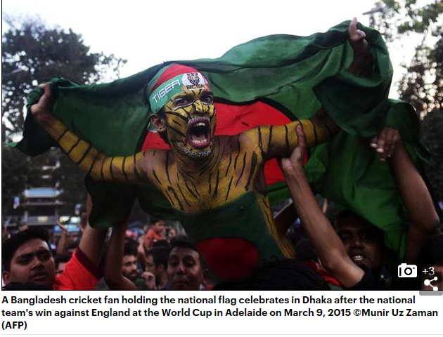
SOME PICTURES OF CELEBRATION

Slide 52
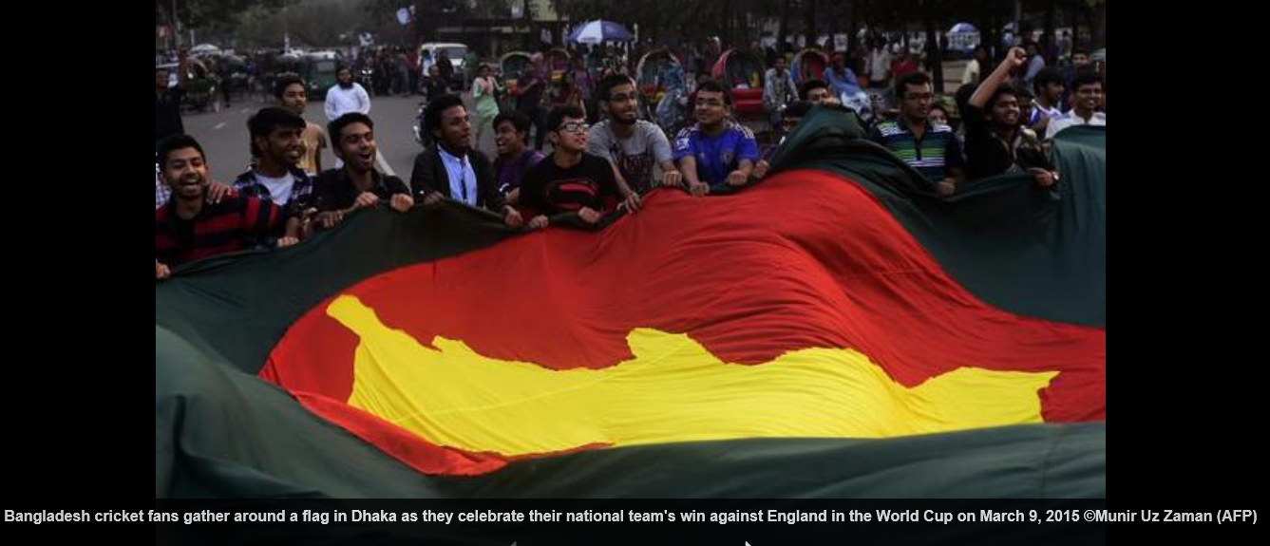
Celebrating Bangladesh’s Win

Slide 53
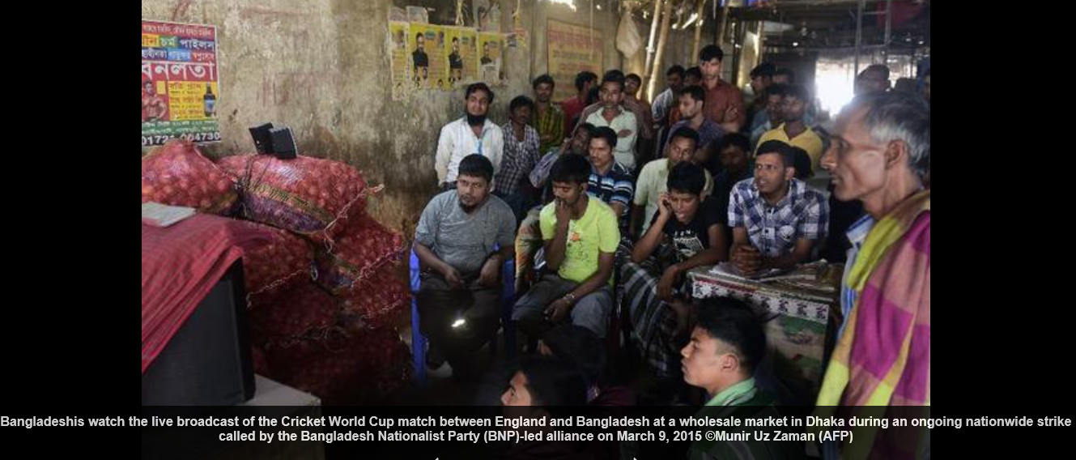
All Kind Of People Watching Cricket to see their team Winning

Slide 54
ICC CHAMPIONS TROPHY 2017
The 2017 ICC Champions Trophy was the eighth ICC Champions Trophy, a cricket tournament for the eight top-ranked One Day International teams in the world.
It was held in England and Wales from 1 June to 18 June 2017.

Slide 55
Bangladesh Journey Through The Tournament
The top eight teams in the ICC ODI Championship rankings as on 30 September 2015 qualified for the tournament, and were divided into two groups of four.
Bangladesh returned to the ICC Champions Trophy for the first time since 2006, while the West Indies failed to qualify for the first time.

Slide 56
Another Historic Win
Not many expected Bangladesh to be there in the semis and that too ahead of Australia or New Zealand, but the beauty of the game lies in its unpredictability.
Fabulous centuries from Mahmadullah and Shakib al Hasan help Bangladesh recover from 33-4 and knock New Zealand out of the Champions Trophy.

Slide 57
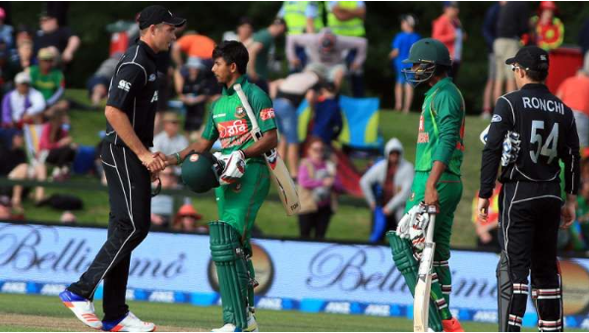
Winning Moment

Slide 58
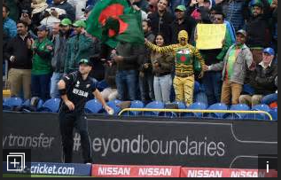
Fans Reaction

Slide 59
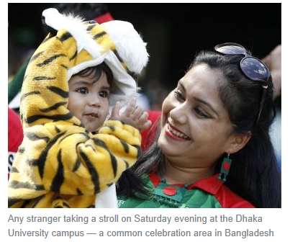
Little Tiger Enjoying Cricket

Slide 60
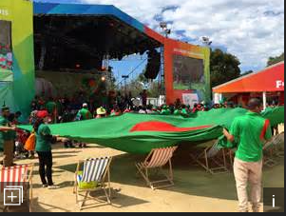
Fans Gathering Together at overseas Also

Slide 61
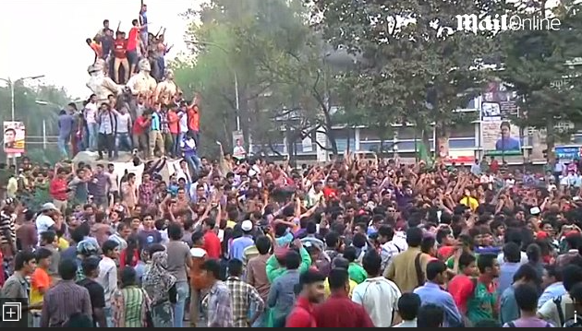
Celebration At Dhaka University

Slide 62
Some Fan Reactions
"Unbelievable! At the start of the tournament, I had imagined a lot of things, but not this one," said cricket fan Shamsul Arefin reacting to the news of Bangladesh qualifying for the semi-final of the ICC Champions Trophy.
“We were indeed planning to bring a procession like we did the other day after Bangladesh defeated New Zealand. ” said Rezaul Karim, a fourth-year student of Management and Information System.

Slide 63
Conclusion
In any big tournament in cricket always put Bangladeshi fans together.
Apart from their daily work they all are searching for entertainment and cricket is one way to entertain them.
Hope in future this unity will keep as same as present situation.

Slide 64
Conclusion(cont..)
Cricketers represent their country to the world through the World Cup. A country is well known to the rest of the cricket-loving world through good playing.
Cricketers are also strictly followed, especially when they are on the cricket ground, so how well they present themselves in fitness, attitude and tact in playing
represents the nation’s identity.

